Slide 1
Project-1 Northpoint Software Production company
By Sri Vamshi polela

Slide 2
Agenda
Introduction
Business problem
Business Goals
Analytic Goal
Data Exploration and preprocessing
Data transformation
Dimension reductions

Slide 3
Agenda
Predictors relevancy
Classifier Model Selection
Model fitting, validation accuracy and test accuracy
Report models performance
Model evaluation (of the selected models)
Calculating the expected spending and gross profit
Gain charts

Slide 4
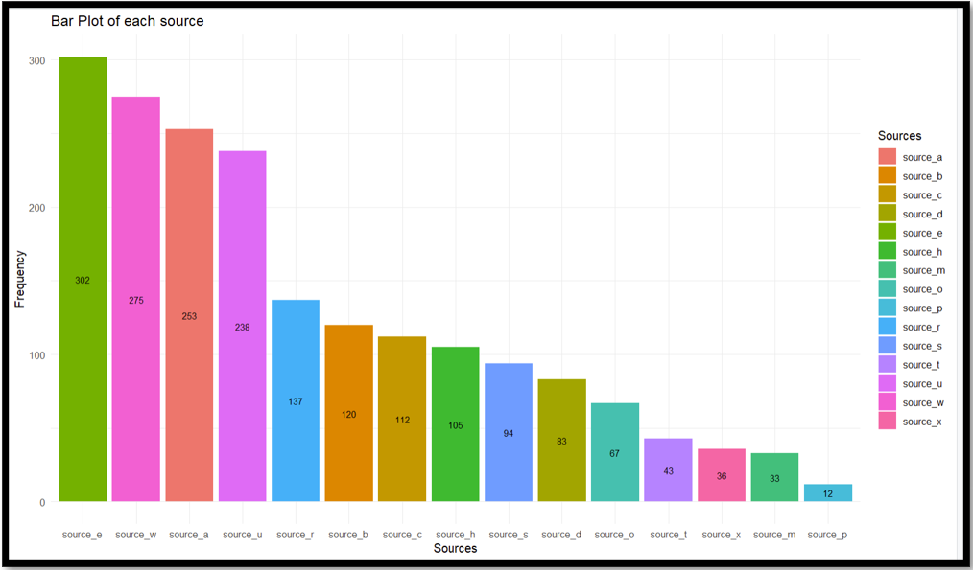
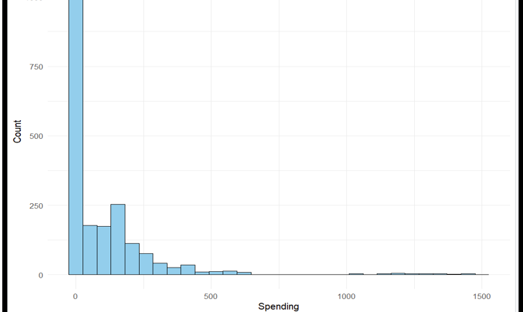
Data Analysis

Slide 5
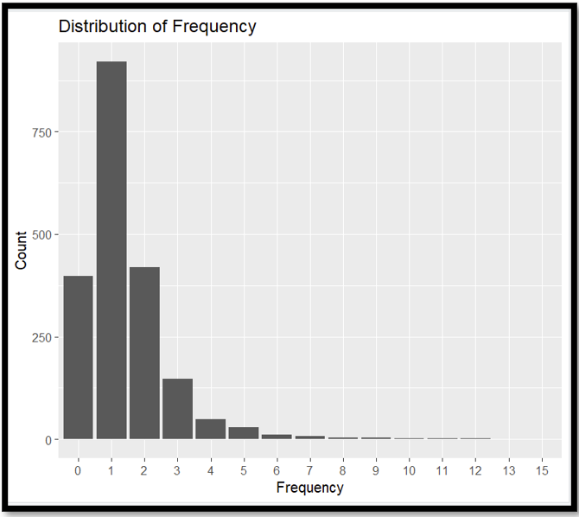
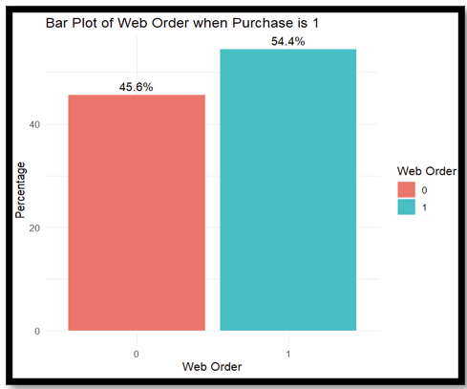

Slide 6
Models SElected
For classification:
Logistic Regression
Classification tree
For Prediction:
Stepwise regression
Regression tree
Random forest

Slide 7
Performance Evaluation – Classification Models
Models | Accuracy | Sensitivity
Logistic regression | 81.14% | 79.48%
Stepwise Logistic regression | 82% | 81.21%
Classification Tree | 78.14% | 79.65%

Slide 8
Performance Evaluation – Regression Models
Models | MAE | RMSE
Regression Tree | 100.581 | 178.41
Stepwise Regression | 109.84 | 176.71
Random Forest | 97.71 | 172.01

Slide 9

Gross profit
The gross profit, calculated at $1,598,075, for 180,000 observations.
This estimate is derived by considering the average spending of purchasers, a purchase rate of 5.3%, and the associated cost of $2 per booklet, covering printing, postage, and other mailing expenses.

Slide 10
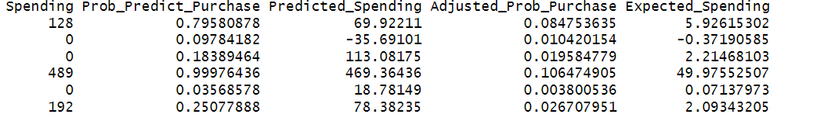
Business requirements

Slide 11
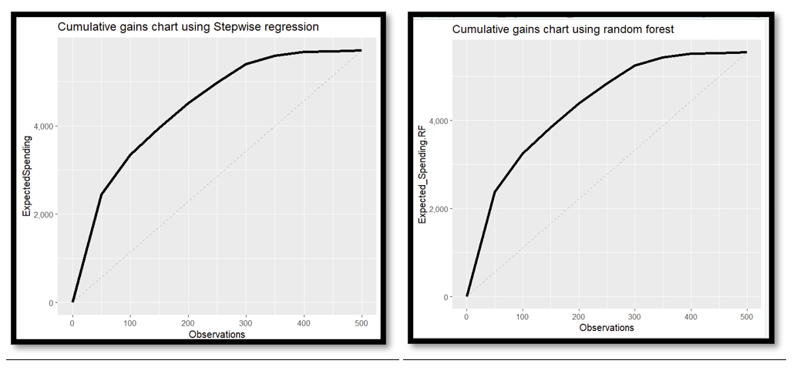
Gain Charts

Slide 12

Business Recommendations:
Target Top 300 Individuals:
Focus marketing efforts on the top 300 targets identified by the model, as indicated by the cumulative gains chart, to capture a significant share of the overall expected spending.
Resource Allocation:
Allocate resources strategically to this specific group to enhance marketing campaign efficiency, ensuring a more effective utilization of resources and maximizing return on investment.

